Slide 1
TNGS Learning Solutions AWS Solutions Architect Online Course Creating a KeyPair

Slide 2
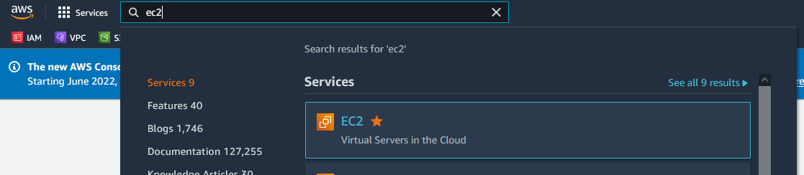
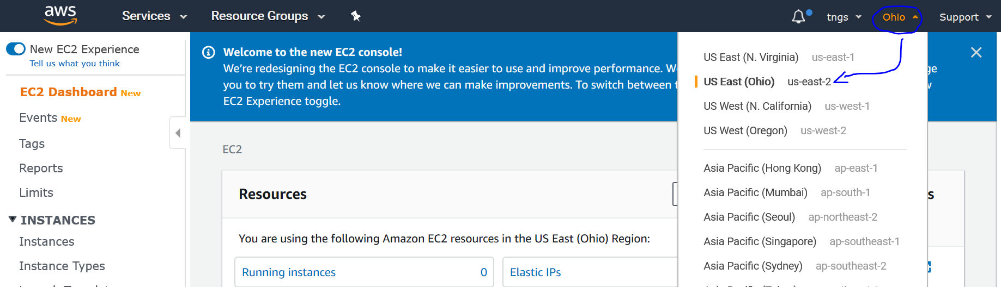
CREATING A KEY PAIR
Open below URL to login to AWS EC2 console.
https://us-east-1.console.aws.amazon.com/console/home?region=us-east-1
In the search bar of console page, type ec2, click on ec2 under services.
Next, select your region from top right-side drop-down menu as shown below.

Slide 3
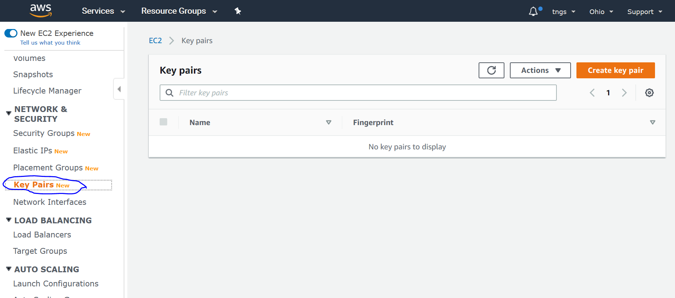
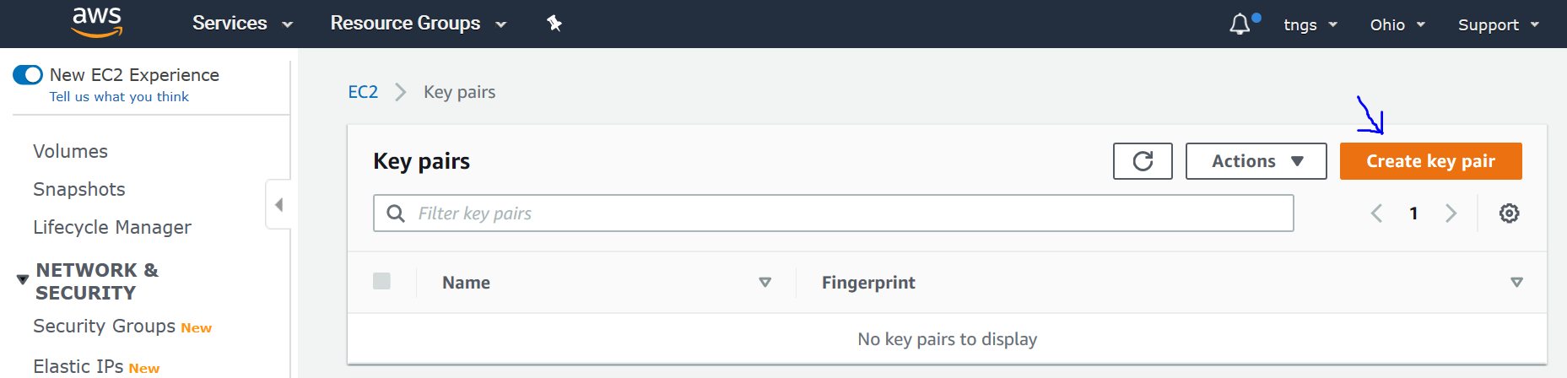
Then Click on Key Pairs under NETWORK & SECURITY menu on the left pane below.
Then Click Create Key Pair on the right upper corner.

Slide 4
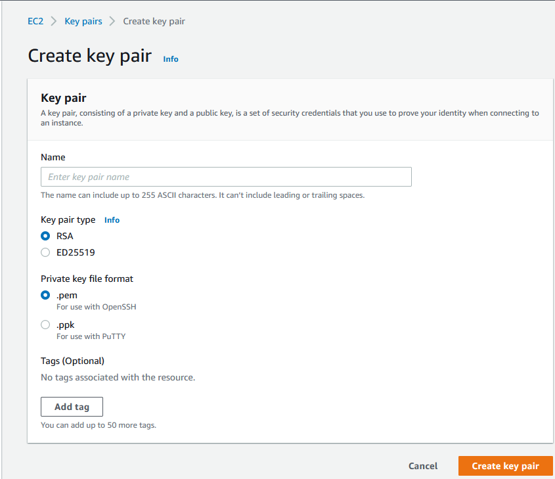
Specify a name for your Key Pair.
Select RSA
Select .pem
Click on Create
Your created key will be saved to your Download folder.
Please verify your keypair exist locally.
This is the only time you will save this key file, so save it somewhere and not it down.
Place your Key Pair in a secure location on your computer..

